Slide 1
Maven
Lesson 03 : Getting Started with Maven

Slide 2
Lesson Objectives
In this lesson, you will learn about:
      Installation and setup Maven
      Download and Install Maven
      Configure settings.xml file
Creating your first project using Maven commands
      Creating Project Template
      Compiling project
      Testing the sources
Notes:
Explain the lesson coverage

Slide 3
3.1.1 Download and Install Maven
3.1 Installation and Setup Maven
Download Maven from Website:
  http://maven.apache.org/download.html
Unzip the distribution archive into the directory you wish to install Maven.
Set these environment variables:
  Maven installation directory:
      M2_HOME=/usr/local/apache-maven/apache-maven-3.3.9.
  Java installation directory:
      JAVA_HOME=/usr/java/jdk1.8.0_31
Set the path to Java and Maven Home environment variables:
  path:
      path =%path%;JAVA_HOME/bin;M2_HOME/bin;

Slide 4
3.1.2 Configuring Settings.xml file
3.1 Installation and Setup Maven
Configure settings.xml file with the following content:
<settings>
<proxies>
<proxy>
<active>true</active>
<protocol>http</protocol>
<host>proxy.company.com</host>
<port>8080</port>
<username>your-username</username>
<password>your-password</password>
</proxy>
</proxies>
</settings>
Notes:
If you are behind a firewall, then you will have to set up Maven to understand and download required plugins from repository. To do this, create a <your-home directory>/.m2/settings.xml file with the following content:
For Example:
<settings>
<proxies>
<proxy>
<id>optional</id>
<active>true</active>
<protocol>http</protocol>
<username>username</username>
<password>password</password>
<host>192.168.104.40.org.com</host>
<port>8080</port>
<nonProxyHosts>local.net|some.host.com</nonProxyHosts>
</proxy>
</proxies>
</settings>
The same configuration can be made in the existing settings.xml file in apache maven home directory. For Example settings can be configured in settings.xml file present in the path C:\apache-maven-2.2.1\conf

Slide 5
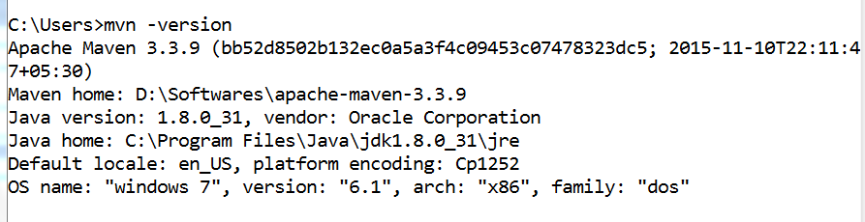
3.1.3 Testing Maven Installation
3.1 Installation and Setup Maven
Testing version of Maven:
  mvn –version
        Gives information of Maven version & environment being used

Slide 6
3.2.1 Archetype Mechanism
3.2 Creating your First Project
Archetype mechanism used to create first Maven Project.
Archetype is a Maven project templating toolkit which is combined with some user input to produce a fully functional Maven project.
To create Maven project execute the following command and follow the instructions:
      mvn archetype:generate
        The full list of archetypes will be displayed
        Choose a number for selecting an archetype and provide the project information.(groupid, artifactId,…)
Example:
      mvn archetype:generate
        DarchetypeGroupId=org.apache.maven.archetypes
        DgroupId=com.mycompany.app -DartifactId=my-app
Notes:
“An archetype is defined as an original pattern or model from which all other things of the same kind are made. “
You may want to standardize J2EE development within your organization so you may want to provide archetypes for EJBs, or WARs, or for your web services. Once these archetypes are created and deployed in your organization's repository they are available for use by all developers within your organization.
Archetypes are packaged up in a JAR and they consist of the archetype metadata which describes the contents of archetype and a set of Velocity templates which make up the prototype project.
To create Maven project execute the following command and follow the instructions:
mvn archetype:generate
If this is the first time you have run the archetype plugin, you will notice that Maven spends some time downloading the archetype functionality as well as the other Java libraries that it uses. These files are stored in your local repository for re-use in
the future.
Once the downloads finish from the earlier archetype command, you will be prompted (with a long list!) to select an archetype to generate the project from.

Slide 7
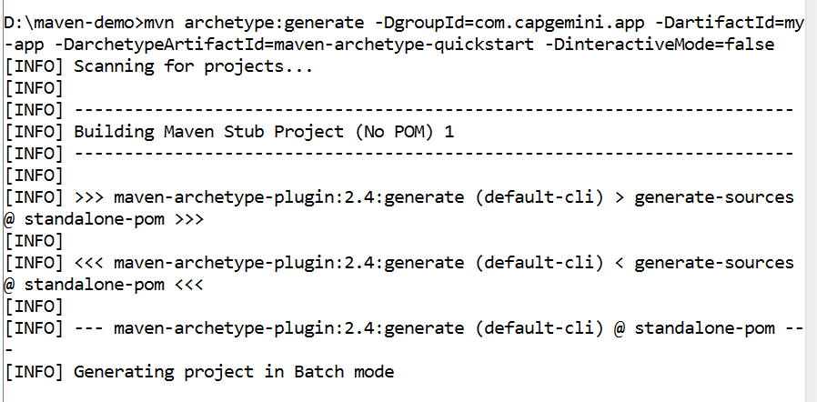
3.2.1 Archetype Mechanism
3.2 Creating your First Project
Notes:
Among the many choices, the default is the quick start archetype that is used in Maven's getting started guide. This is a good choice for a minimal Maven project or an archetype from which new modules can be built (particularly for JAR projects).
Each Maven project needs some coordinates to allow it to be identified by other Maven projects. These are called the group ID, artifact ID, and version (sometimes referred to as the GAV).
Group ID: An identifier for a collection of related modules. This is usually a hierarchy that starts with the organization that produced the modules, and then possibly moves into the increasingly more specialized project or sub-projects that the artifacts are a part of. This can also be thought of as a namespace, and is structured much like the Java package system.
Artifact ID: The Artifact ID is a unique identifier for a given module within
a group.
Version: The version is used to identify the release or build number of
the project.

Slide 8
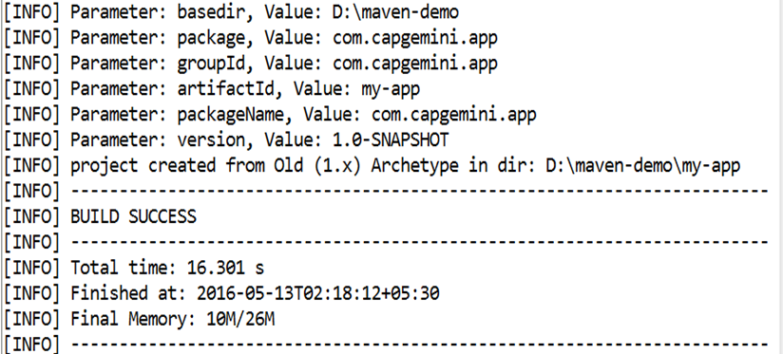
3.2.1 Archetype Mechanism
3.2 Creating your First Project
Notes:
In Maven, there are two types of versions: releases and snapshots (those that end in -SNAPSHOT). A snapshot should always be used by the projects during development as it has a special meaning to Maven to indicate that development is still occurring and that the project may change. A release is assumed never to change, so release versions (such as 1.1, 2.0, or 3.0-beta-5) should only be used for a single state of the project when it is released, and then updated to the next snapshot.
The final prompt for a package is the Java package that will be used for source code. It is not the packaging type that to take by the project as that is provided by the archetype itself.
After entering the values above, prompt will be displayed to confirm that the values are as you intended, and then the project will be created. If the below highly desirable banner displayed, then congratulations—Maven project created successfully!
[INFO] ------------------------------------------------------
[INFO] BUILD SUCCESSFUL
[INFO] ------------------------------------------------------

Slide 9
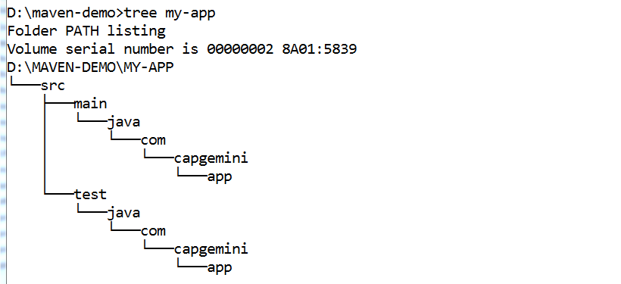
3.2.2 Viewing Project strcture
3.2 Creating your First Project
To view the project structure which is created based on archetype, execute the following command:
      tree application-name
The src/main/java directory contains the basic java application, while pom.xml specifies the information Maven needs to know.
This directory structure has followed the Maven convention, which requires a minimal amount of configuration to construct a functional build.

Slide 10
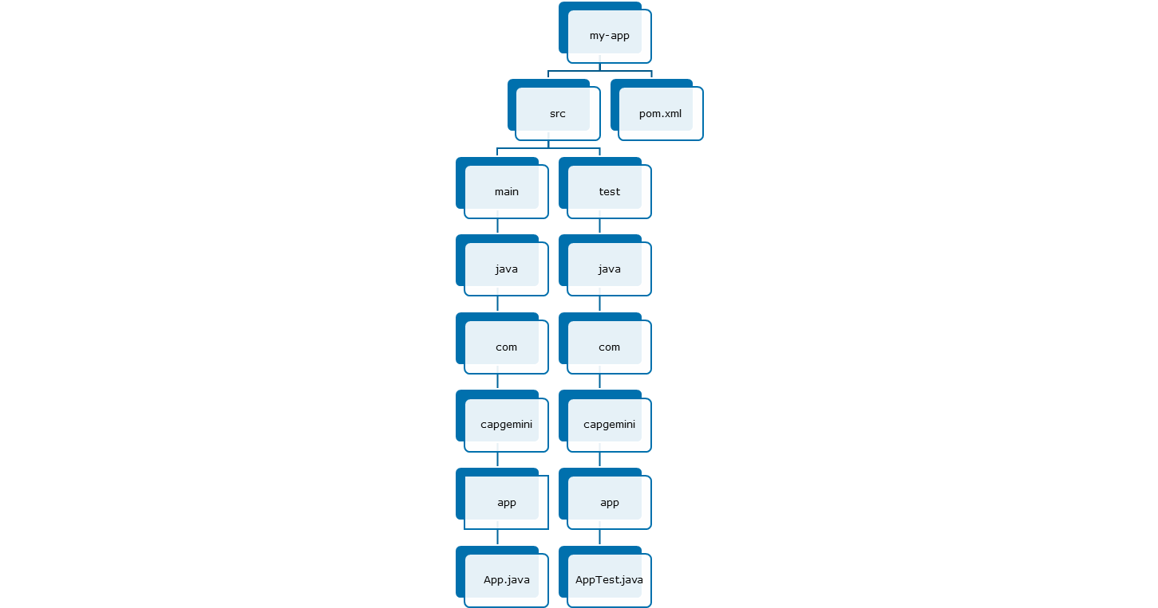
3.2.1 Archetype Mechanism
3.2 Folder Structure

Slide 11
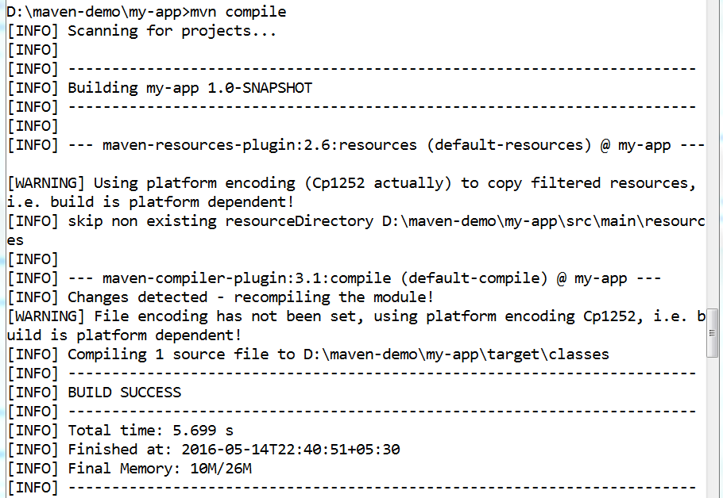
3.2.3 Compiling Project
3.2 Creating your First Project
For Compiling your application sources, execute the following command:
      mvn compile
Notes:
For Compiling your application sources, execute the following command:
mvn compile
After compilation, the compiled classes generated in the default target directory i.e) target/classes.
The compiler plugin was used to compile the application sources, that maps to the Maven's default build life cycle.

Slide 12
3.2.4 Testing Project
3.2 Creating your First Project
After successfully compiling application's sources, testing phase in the lifecycle will be performed.
Use the following simple command to test:
      mvn test
Before compiling and executing the tests, Maven compiles the main code.
mvn test will always run the compile and test-compile phases.
      compile : Compiles Application sources.
      test-compile: Compile tests
Test logs are written under target/surefire-reports.
Debugging an application can be done by viewing the test logs.
Notes:
After successfully compiling application's sources, testing phase in the lifecycle will be performed.
Use the following simple command to test:
mvn test
Maven downloads more dependencies this time. These are the dependencies and plugins necessary for executing the tests.
Before compiling and executing the tests, Maven compiles the main code.
mvn test will always run the compile and test-compile phases.
compile - Compiles the application source codes.
test-compile - compiles the test codes.

Slide 13
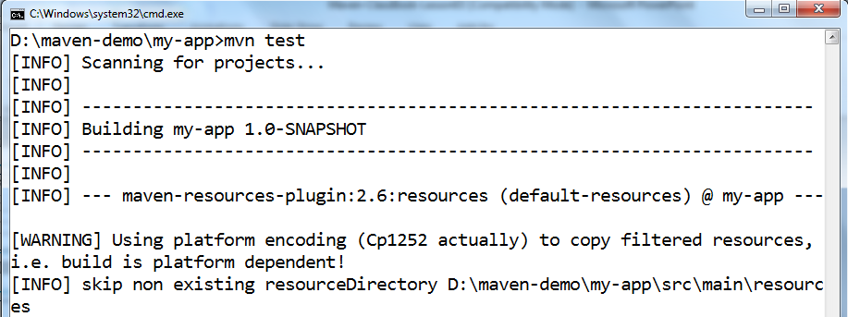
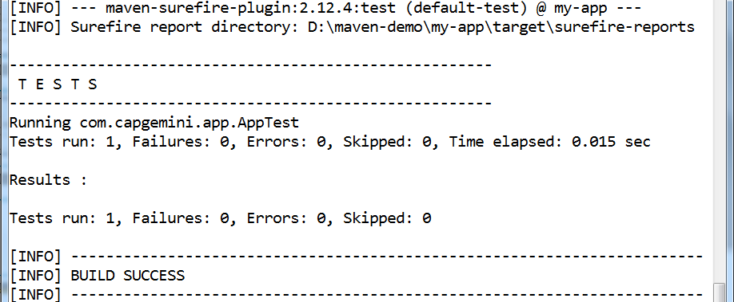
3.2.1 Archetype Mechanism
3.2 Creating your First Project

Slide 14
3.2.5 Packaging and Installation to Local Repository
3.2 Creating your First Project
Packaging an Application
  Artifact creation can be accomplished by executing the following command:
        mvn package
  Artifact will be created based on the packaging element value in the pom.xml file.
  ../target directory contains generated artifact of a project.
Installation of artifact into local repository:
  The directory <home directory>/.m2/repository is the default location of the repository
  Once artifact installed, it can be used by other projects as a dependency.
  To install, execute the following command:
        mvn install
Notes:
Packaging an Application:
Artifact creation can be accomplished by executing the following command:
mvn package
Artifact will be created based on the packaging element value in the pom.xml file.
../target directory contains generated artifact of a project.
Installation of artifact into local repository:
The directory <home directory>/.m2/repository is the default location of the repository
Once artifact installed, it can be used by other projects as a dependency.
To install, execute the following command:
mvn install
This command can be used instead most of the time, as it will process all of the previous phases of the build life cycle (generate sources, compile, compile tests, run tests, etc.).

Slide 15
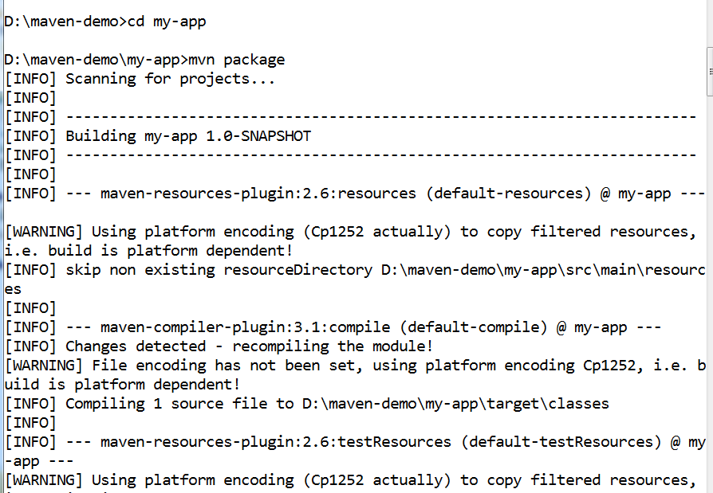
3.2.1 Archetype Mechanism
3.2 Creating your First Project

Slide 16

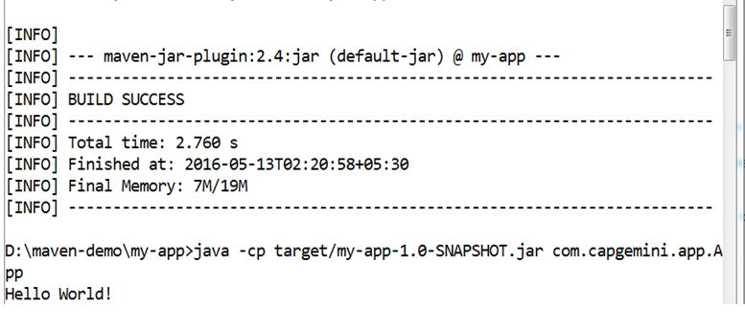
3.2.1 Archetype Mechanism
3.2 Creating your First Project

Slide 17
3.2.6 Implementation of rich features in Maven
3.2 Creating your First Project
Creating a simple site for a project can be done by running a command:
    mvn site
To remove target directory and remains project with old build data, execute the following command:
    mvn clean
Help command:
      mvn help
  For an example, to view the options for the maven-compiler-plugin, use the following command:
        mvn help:describe -DgroupId=org.apache.maven.plugins \
        DartifactId=maven-compiler-plugin -Dfull=true

Slide 18

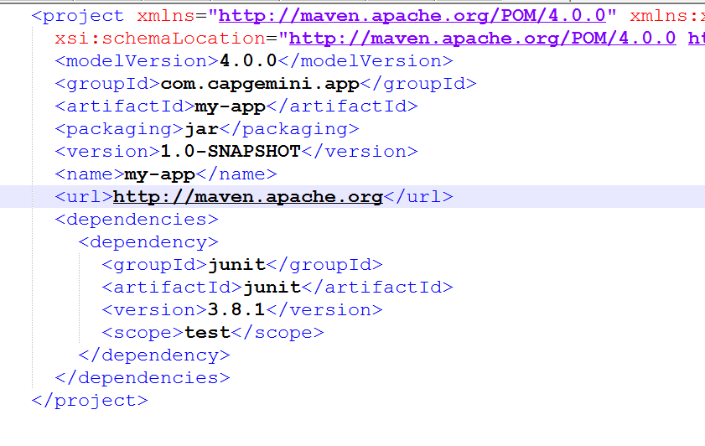
3.2.3 Generated POM.xml
3.2 Creating your First Project
Notes:
The archetype has substituted the coordinates that it prompted for earlier in the pom.xml file . It has also added the jar packaging type to indicate that the build structure for the project is a Java application. A default name has been added, which you would typically change to something which describes the project better.
Maven's declarative project model defines a number of well-known properties that the whole build can reuse for a number of different purposes. For Example, even javadoc can be produced if requested.
The POM contains important pieces of information about the project, which include:
The Maven coordinate of the project for reuse by other Maven projects
The project name, description and license
Project resource information such as the location of source control, issue tracking, and continuous integration
The developers, contributors and organizations participating in the project
The POM will also include information about how the project should be built, such as:
The source directory layout
Dependencies on other projects
Build requirements (by means of Maven plugins) and configuration

Slide 19
3.2.7 Demo on Project creation
3.2 Creating your First Project
Creating and executing the “Hello World!” program

Slide 20
3.2.8 Demo on Project creation
Lab: 1
1.1 : Getting Started With Maven
1.2 : Configuring Maven Settings
1.3 : Creating first standalone Maven application using archetype

Slide 21
Summary
In this lesson, you have learn about:
  Installation and setup Maven
      Download and Install Maven
      Configure settings.xml file
Creating your first project using Maven commands
      Creating Project Template
      Compiling project
      Testing the sources
Notes:
Explain the lesson coverage

Slide 22
Review Question
Question1: _________ command execution will remove target directory and remains project with old build data.
      mvn compile
      mvn clean
      mvn stage
      mvn verify
Question2: Maven stores all the software libraries or artifacts in stores called a repository.
      True
      False
Notes:
Answers for the Review Questions:
Question 1: mvn clean
Question 2: True

